Slide 1
Bring Mathematics into Biology: Past, Present and Future impact on Health
Marta Milo
University of Sheffield
Department of Biomedical Science

Slide 2
Outline
Introduction and challenges,
why we can look at biology as networks
Role of uncertainty in biology
Identify different components of the biological network
GRASPS and the prospect of the translatome
Going deeper in the cell
genetic variability in human PSCs
DATA integration models
Conclusion and open questions..

Slide 3

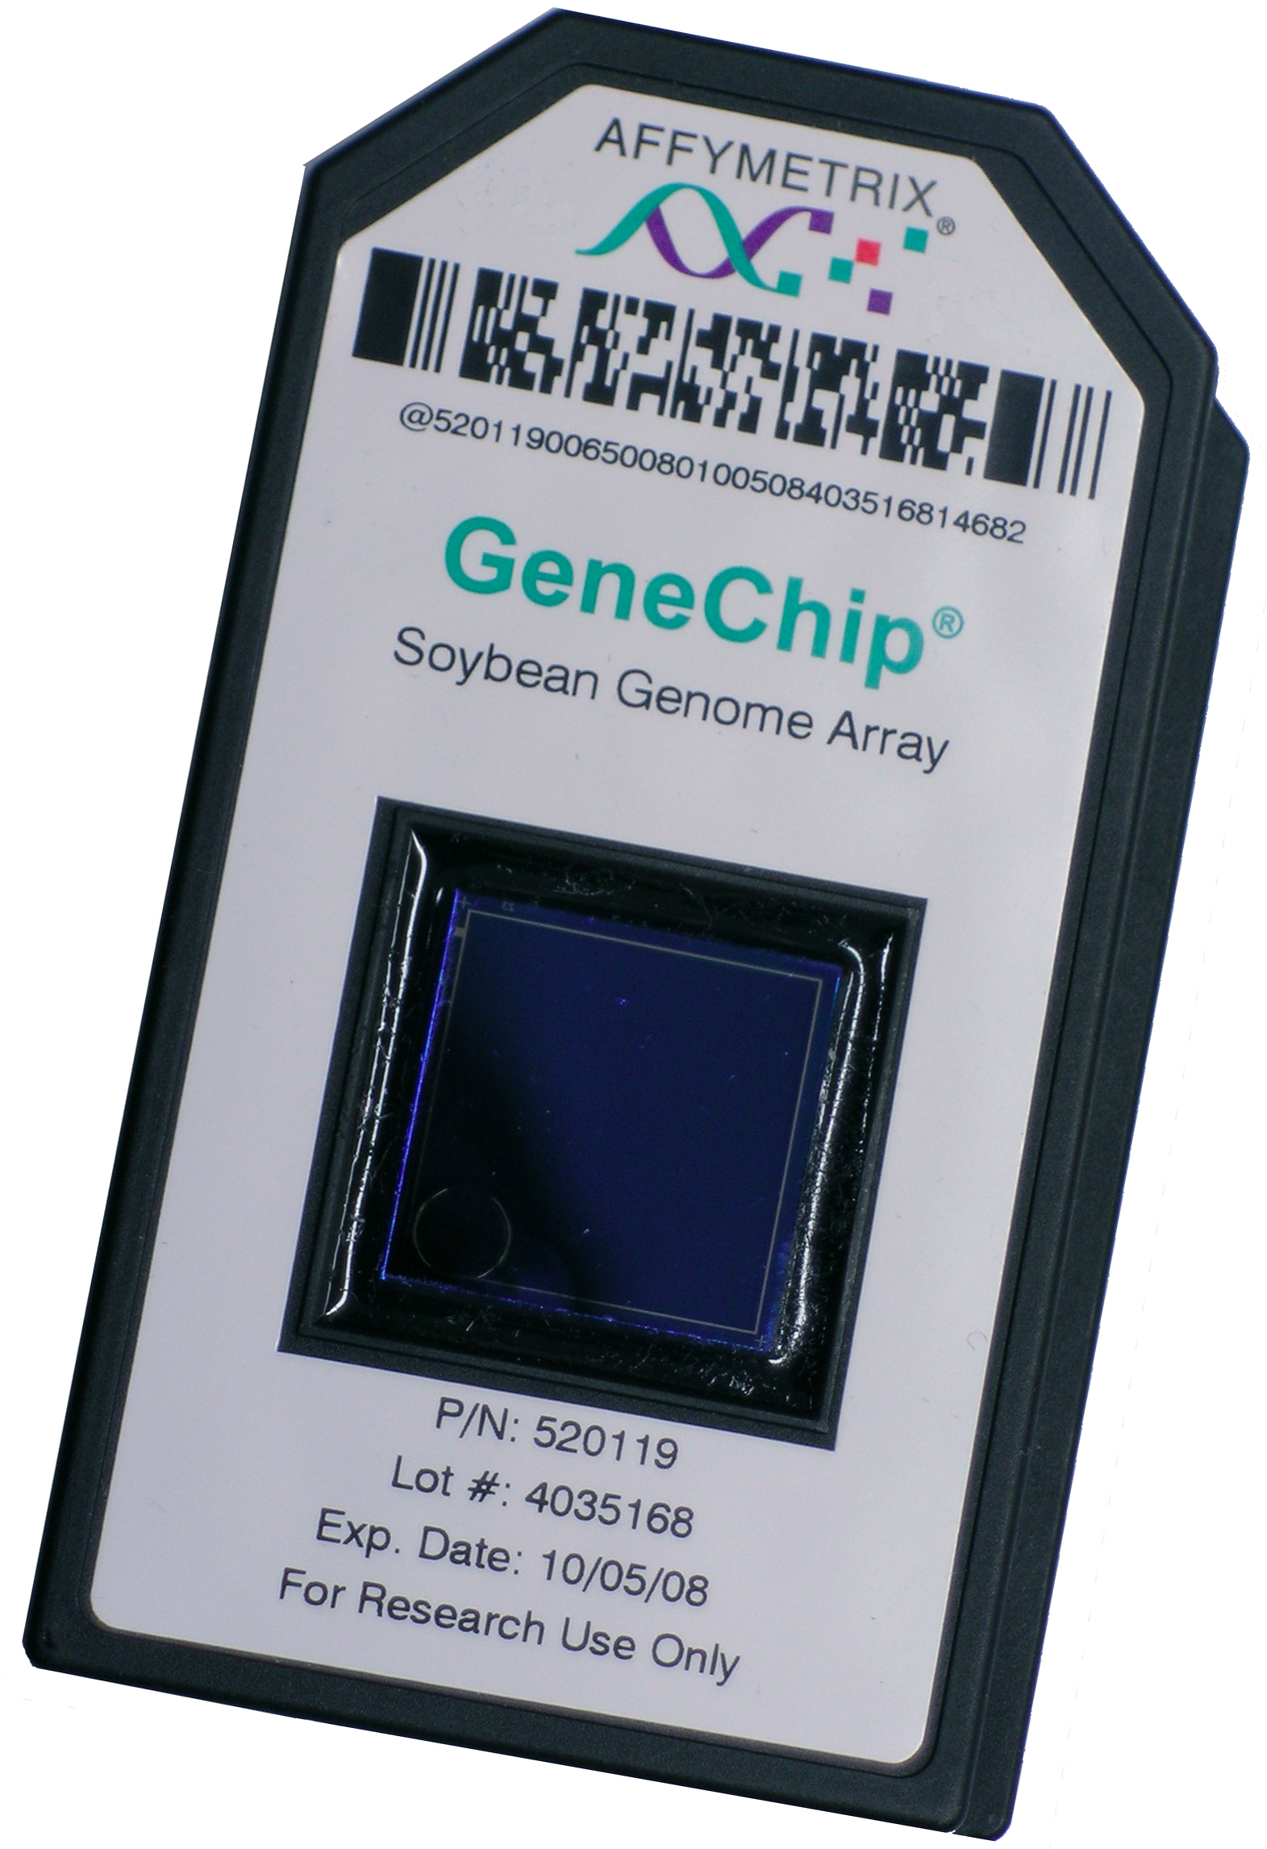

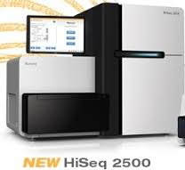
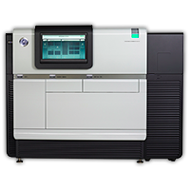
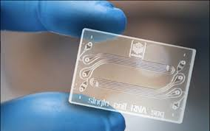
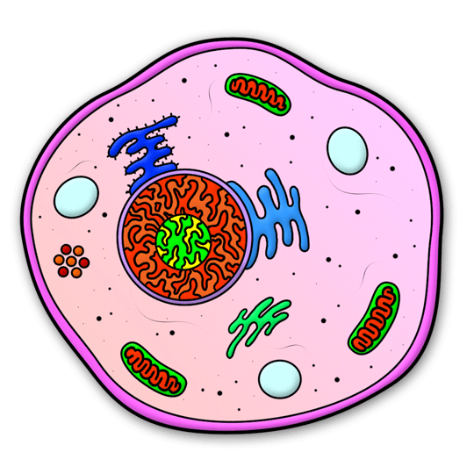
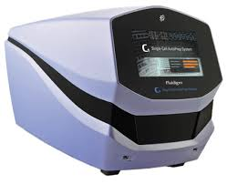
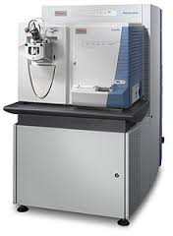
There was the darkness of the microscope room….
Human Genome Project
Past – HGP
Each gene to be probed one at a time. Biological systems were investigated by examining their parts in isolation. System-level analysis only theoretically possible
HGP – present
Ability to probe and quantify activity of every gene. high–throughput profiling studies enabling systems–level analyses, with integrative approaches to elucidate the functional associations between differentially expressed genes.
+
+
Present –Future
“omics” analysis at single-cell resolution enabling understanding of details of complex
biological phenomena. Characterise cellular cellular composition of complex tissues, find new microbial species. Fine level of network complexity

Slide 4
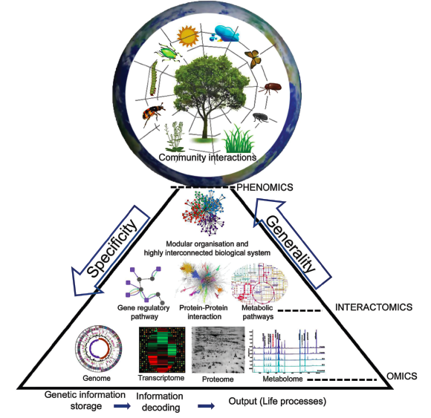
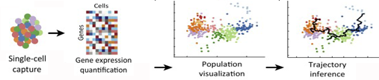
Biology as Networks
OMICS and its hierarchy
The highly interconnected hierarchical organization and functional complexity needs a sophisticated integrated systems approach.
Single-cell omics
Adapted from Journal of Experimental Botany, Vol. 66, No. 2 pp. 479–493, 2015

Slide 5
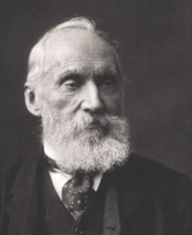
The role of Uncertainty
In quantitative sciences numerical knowledge is not enough to understand and predict systems behaviors that are only partially observed. Predictions of future events and observed measurements are subject to uncertainty that comes from the unknown.
Lord Kelvin defined non-numerical knowledge “meagre and unsatisfactory”.
To serve the purpose, measurements must be susceptible to comparisons. Comparability of measurements requires some common understanding of they accuracy and ways of measuring and expressing the uncertainty in their values.
The History of Statistics: The Measurement of Uncertainty Before 1900, Stephen M. Stigle
In biology the complexity of the systems is such that we cannot measure everything and predictions of data required an additional “knowledge” to become meaningful.
This “knowledge” needs to be quantified in a way that reflects our prior knowledge of the systems and what we were able to measure (observe) and adjusted once the measurements are computed. It opens the way to quantifying uncertainty.

Slide 6
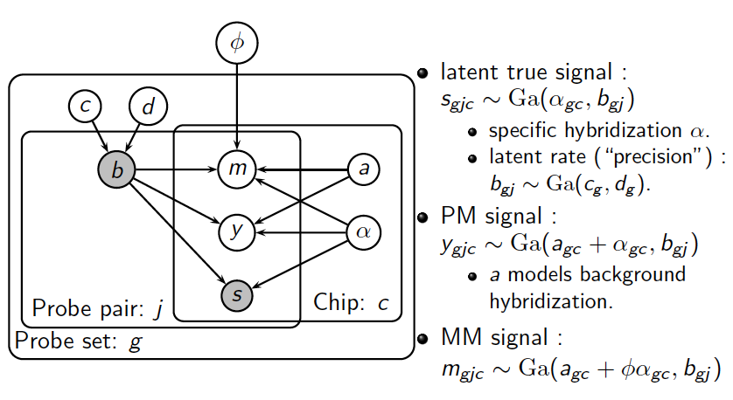
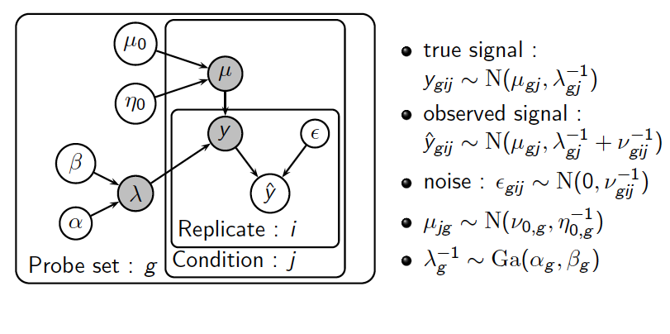
Using Uncertainty in OMICS
Transcriptomics:
Puma: propagating uncertainty in microarrays data C
Milo M et al, Biochem transcation 2003
Liu X et al, Bioinformatics 2005
Pearson R et al, BMC Bioinformatics, 2009
Uncertainty was used in many down streams applications:
Differential expression
Clustering
Probabilistic PCA
Notes:
pumaComb: Bayesian hierarchical model that incorporates the probe-level error into the variance estimate. Since the Bayesian hyperparametr estimate is intractable we use Variational Inference to obtain the posterior distribution.

Slide 7
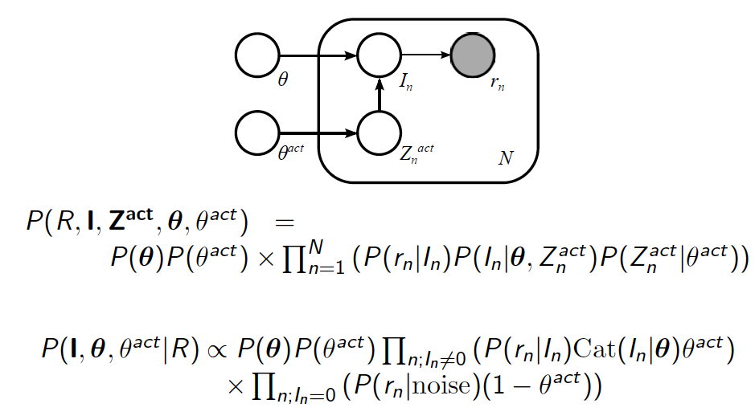
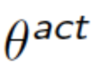
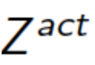
RNA-seq estimation…
Aims:
Estimate expression of transcripts from RNA-Seq data
Find differentially expressed transcripts in multiple conditions while accounting for biological variation and quantify uncertainty to avoid spurious call
To do Bayesian inference using Variational Bayes Inference
gene expression ≈ sum over transcript expression
= noise
Resources:
Glaus P., Honkela A., and Rattray M. (2012). Bioinformatics, 28(13),1721-1728.
doi: 10.1093/bioinformatics/bts260
Package: Bioconductor 2.10
standalone at http://code.google.com/p/bitseq/
Notes:
Proper sample preparation allows that the number of reads aligning to a certain gene is approximately proportional to the abundance of fragments of transcripts.
Categorical distribution is also called a "generalized Bernoulli distribution" or, less precisely, a "discrete distribution") is a probability distribution that describes the result of a random event that can take on one of K possible outcomes, with the probability of each outcome separately specified.

Slide 8
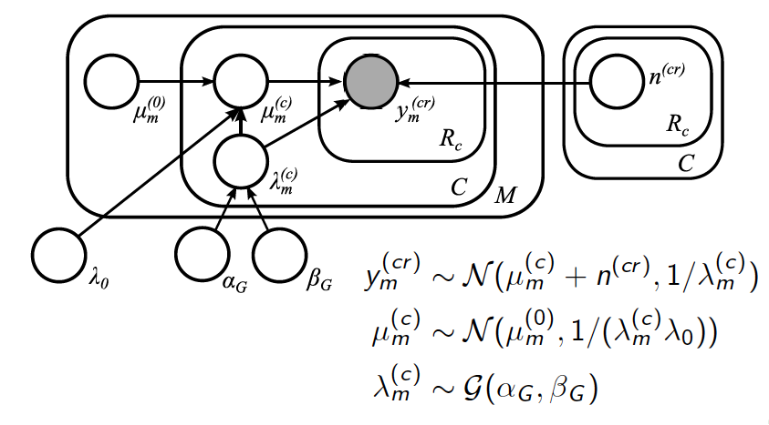
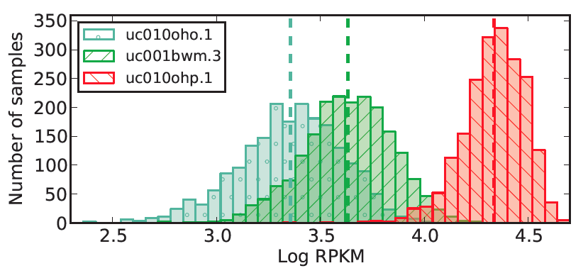
RNA-Seq: bitSeq approach (cont.)
Log of transcripts expression transcripts
Sample preparation need to be such allows that the number of reads aligning to a gene is approximately proportional to the abundance of fragments of transcripts.
Very sensitive and difficult to interpret in the context of biological complexity.. Integrating with “knowledge” from literature or experimental science.

Slide 9
Our Aims as a Computational Biologists
Basic statements in biology: everything can be explained in patterns, recurrent states of biochemical reactions and dynamical system changes. Mathematics can help to define systematic rules in predicting behaviors but there is a lot of uncertainty.
Combine gene–level analyses with pathway–based methods to generate a comprehensive profile of the functional modules that govern biological processes.
We want to use high–throughput data to build predictive models at the systems level.

Slide 10
Biological Data: a network of complex interaction
Regulatory mechanisms in molecular biology
Small RNAs
Translatome
t + Δt
DNA
mRNA
t + Δt₂
Proteins
t
Transcription Factors
t + Δt₃
DNA methylation
(Epigenetics)
t + Δt₁
Snapshot at a time t?
Adapted from Braun R, Adv Exp Med Biol. 2014; 844: 153–187
Notes:
Regulatory mechanisms in molecular biology. DNA is transcribed to messenger RNA and then translated into protein. The rate of transcription is controlled by a feedback loop in which the level of transcription factor proteins is regulated the activity of the transcriptional complex, and genes can be permanently silenced by methylation of cytosine in CpG promoter regions of the DNA sequence. More recently, it has been discovered that the expression of small non-coding RNA molecules (e.g., microRNAs) can downregulate entire sets of genes by binding to complementary sequences in the messenger RNA.

Slide 11
Impact of uncertainty in ALS translatome
Quantification of Translating mRNA in Amyotrophic Lateral Sclerosis (ALS): identify proteins that play a specific role in the individual progression of the disease
Isogenic cell line – control lines and with mutation in TDP-43 gene
3 replicated cultures for each condition
- whole cell mRNA
- cytoplasmic mRNA
- ribosomal captured mRNA
Samples are subject to different “timing” within the cell cycles, ubiquitination and post transcriptional effect
High complexity but very low sample size
Uncertainty needs to be evaluated together with the transcripts abundance
G. Hautbergue et al.
( in progress)

Slide 12
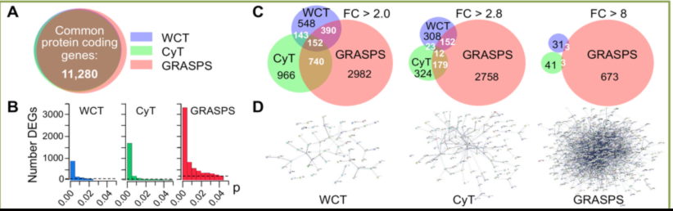
Impact of uncertainty in ALS translatome
Quantification of Translating mRNA in Amyotrophic Lateral Sclerosis (ALS)
Strong presence of Alternative Splicing witch produce multiple mRNA transcripts;
regulate gene expression in response to environmental stimuli and developmental changes;
Regulation of gene expression after transcription and before translation;
Enrichment Scores:
log₂ FC > 1.0
log₂ FC > 1.5
log₂ FC > 3
Protein transport/ localization 4.1 5.9 4.9 1.8 1.5 5.3 - - -
Protein degradation/ ubiquitin 3.3 4.0 14.4 - 4.7 12.9 - - 2.6
RNA splicing/ processing 3.2 1.4 4.2 - - 3.5 - - 4.7
Cell death/ apoptosis 1.7 3.1 6.1 - 2.7 4.8 - - 3.6
Cell cycle 1.5 6.0 8.9 - 8.3 9.3 - - 3.1
Phosphorylation - 2.4 3.8 - 2.1 4.5 - - 3.3
RNAPII transcription - 1.8 2.4 - 2.6 2.4 - - 1.6
RNA export & transport - - 1.9 - - 1.6 - - 1.6
Hexose metabolic process - - 2.5 - - 1.9 - - -
Aerobic respiration - - 2.0 - - 2.6 - - -
tRNA aminocylation - - 1.7 - - 3.5 - - -
Neuron differentiation - - 1.9 - - - - - -

Slide 13
Stem Cell therapy using hPluripotent Stem Cells
hPSCs in culture acquire mutation in their genome. Using Inhibitors in culture medium and specific culture protocols, can improve the proliferation of cell carrying CNVs.
In clinical grade line it is required ABSENCE of CNVs for cell therapy. This is very difficult to obtain. Limitations in advances in the field.
How do we quantify the mutation burden of hPSCs in culture and how we can minimise it?
How can we identify functional significant genetic and epigenetic variants during hPSCs production for efficient translational use at individual bases?
Are there somatic signatures that can help to identify mutagenesis?
Are some lines better at making specific cell types?
Notes:
What is relevant and what is ambiguous?

Slide 14
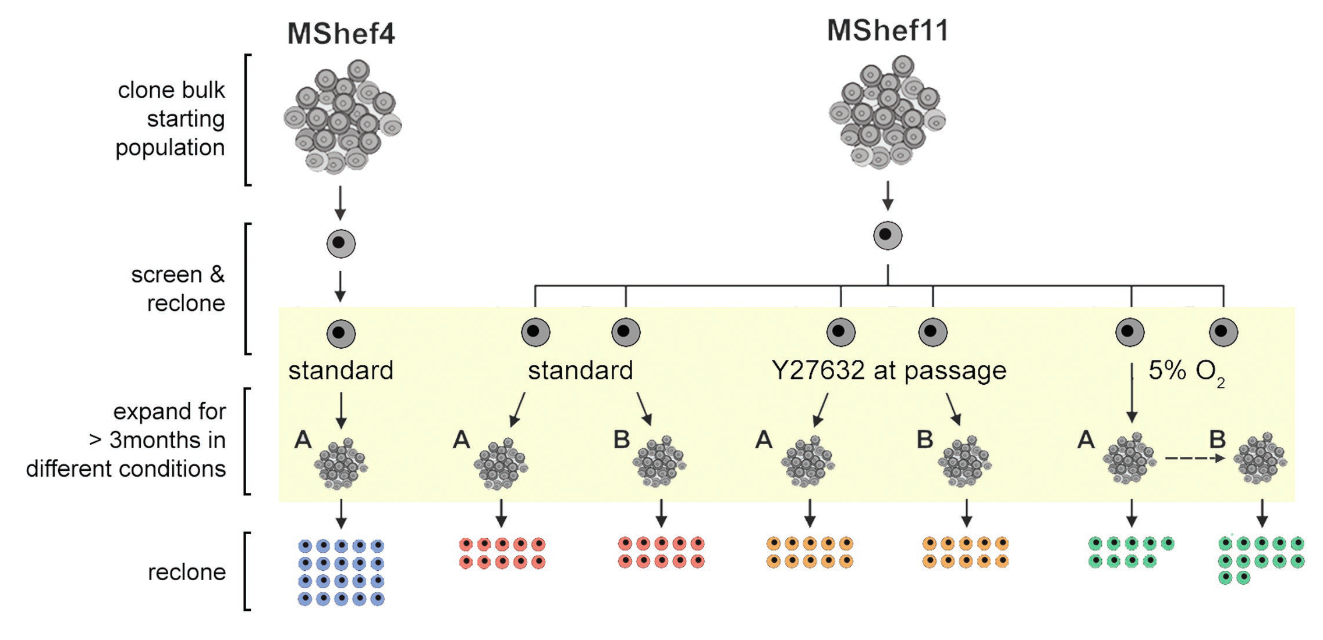
How do we identify the mutation burden in culture and how we can minimise it?
Estimating mutation rate in different culture condition using whole genome sequencing
Whole genome sequencing; mRNA sequencing; DNA methylation sequencing
In collaboration with the Sanger

Slide 15
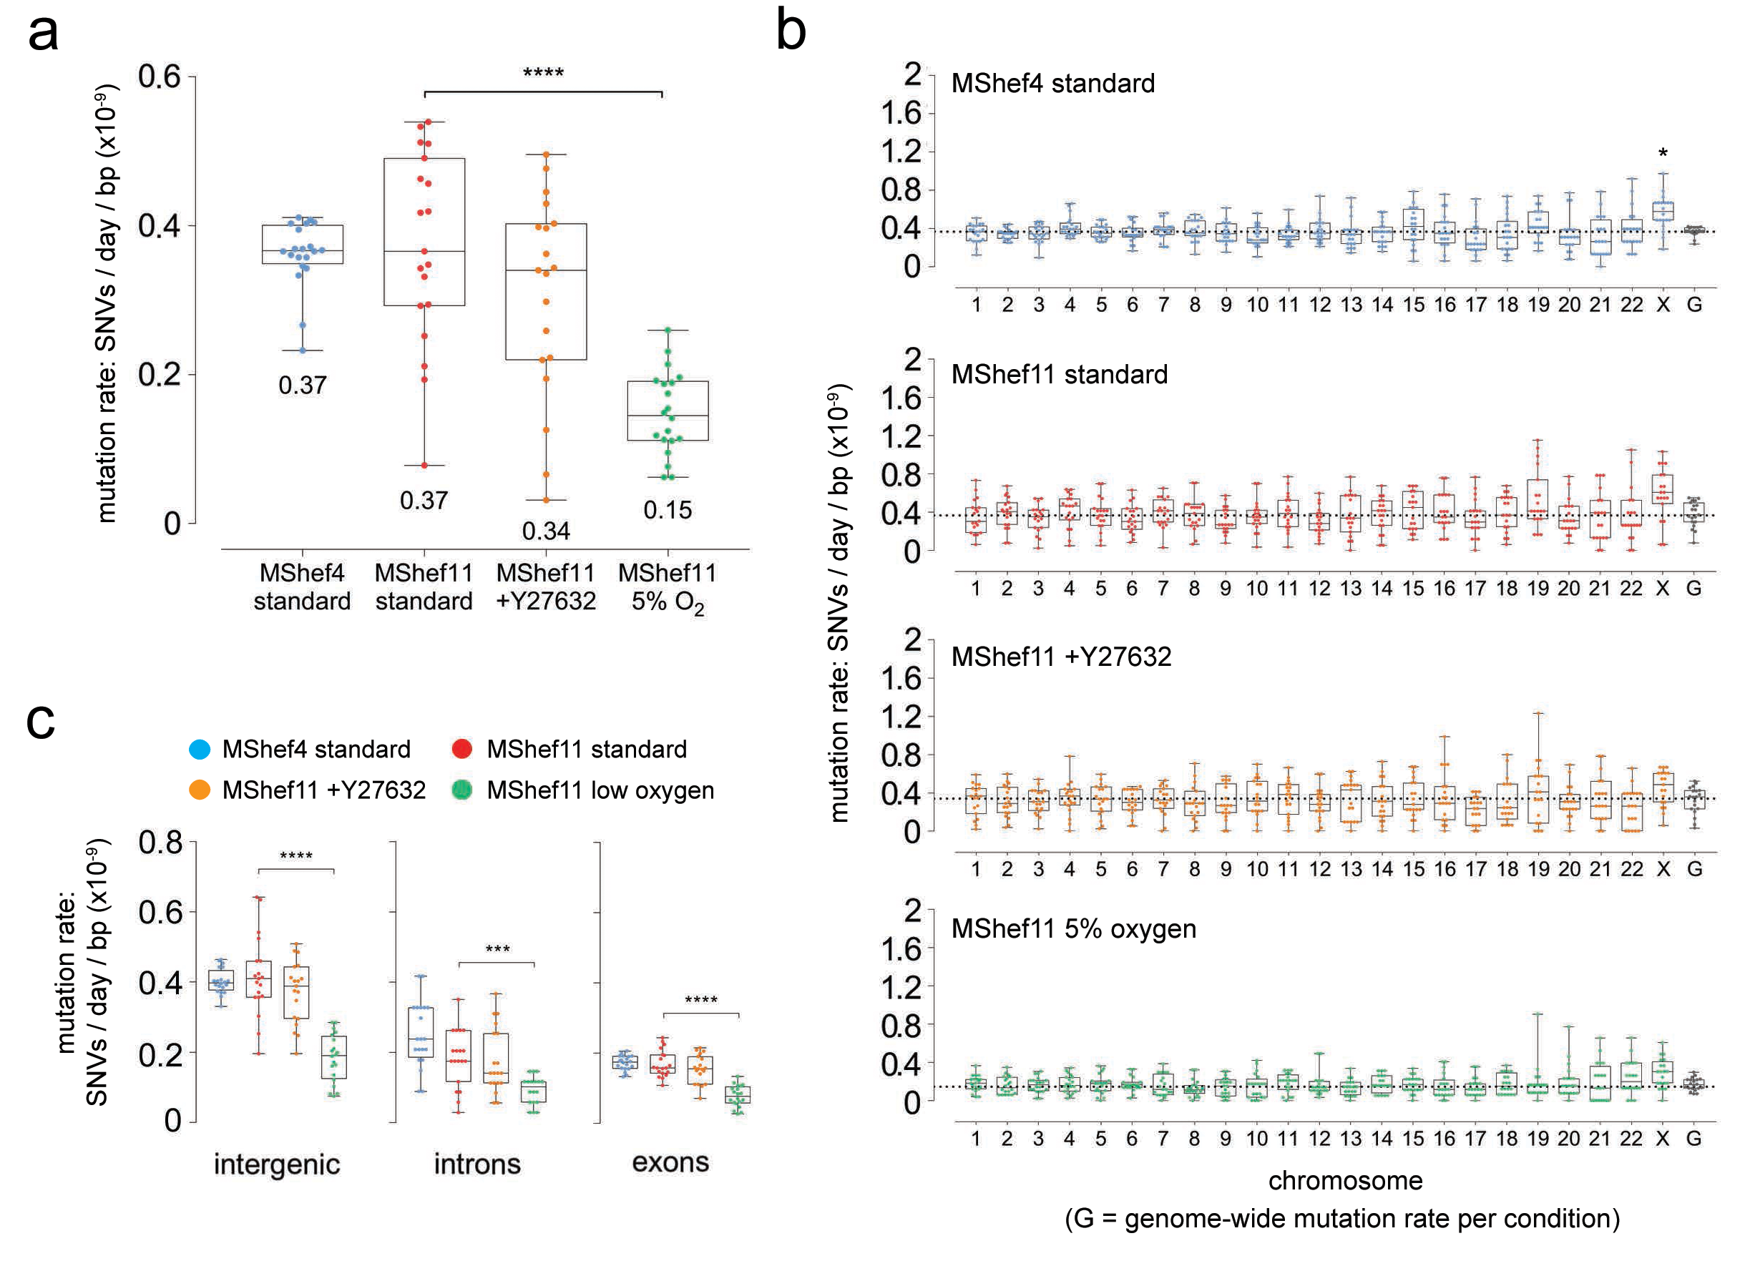
How can we identify functional significant genetic and epigenetic variants?
ISCI project identified areas of “hot spots” in the genome by studying stem cell lines from different population – We could use the information as a prior to rank the impact of CNVs if we notice obvious difference in mutation burden
Genetic variants

Slide 16
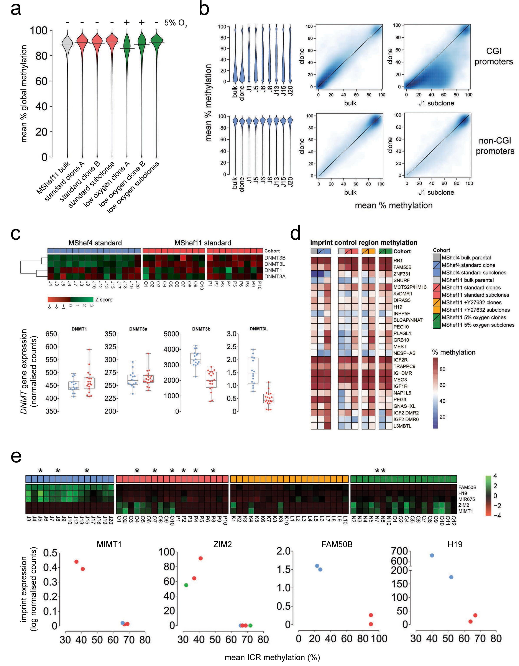
Epigenetic variants
In low oxygen there is show a small decrease in methylation, This decrease in methylation is reversible.
Hyper-methylation in promoter regions of subclones of one line

Slide 17
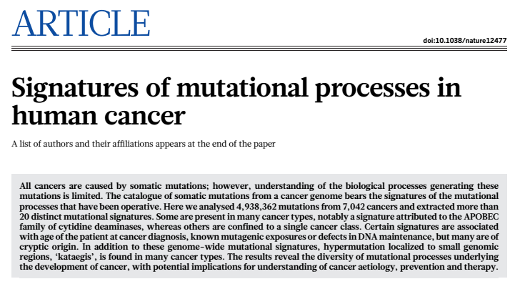
Are there somatic mutation signatures that can help to identify mutagenesis in hPSCs?
Alexandrov and Nik-Zainal et. al. Nature 2013, vol 500
Somatic mutations are divided into six sub-groups
C:G > A:T
C:G > G:C
C:G > T:A
T:A > A:T
T:A > C:G
T:A > G:C
1. Each group has a probability p_{i} to occur, that are discrete and independent. Each genome will also be treated separately.
2. We assume that a number of N processes (P) can cause one of the six the mutation type.
3. p1i is the probability of process P1 to cause the mutation feature corresponding to the i-th type
4. The matrix that is then created is transformed to segregate out noise using a technique called Minimum Noise Fraction Transformation.

Slide 18
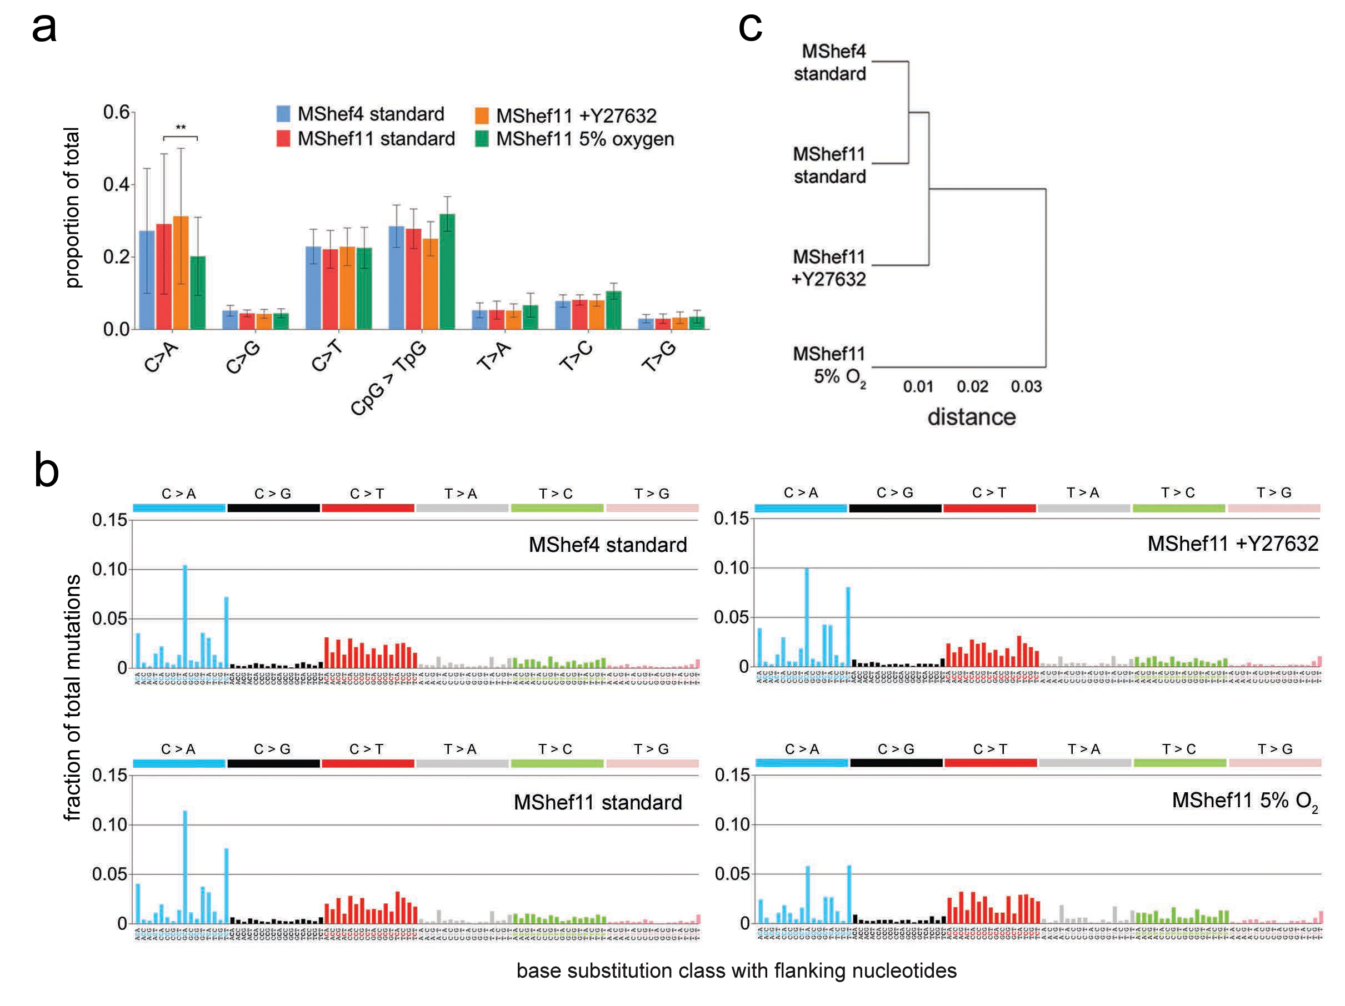

Slide 19
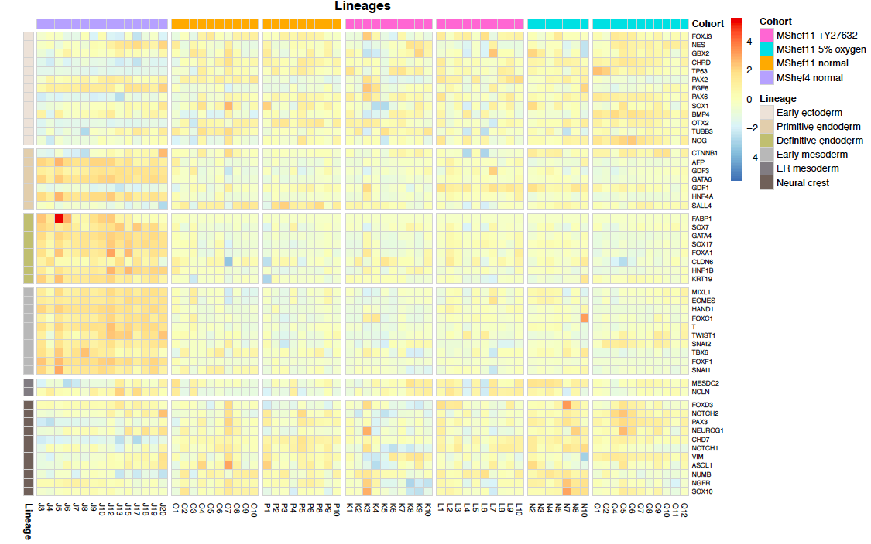
Are some lines better at making specific cell types?
RNA-Seq analysis of subclones

Slide 20
Summarising results…
The mutation burden of the hPSCs in culture is low, and does not identify obvious hotspot.
There are chromosomes that are mutated more in exons but not very obvious.
hPSCs signature correlation with COSMIC signatures shows:
- Signature 1-3 have ~ 85% similarity with a signature observed in cells that had been in vitro typical oxidative stress profile.
- Signature 4 have ~ 77% similarity with a proliferation cancer-signature
There are changes in the methylation profile for different culture condition and for genetic background.
Not clear characterisation of the transcriptome but some patterns are visible
What does this really mean?

Slide 21
Data Integration: aims
We want to build a model that explains correlation structures across OMICS using the uncertainty embedded in the data.
Predicts effects of these correlations at different scales and from disparate data sources, in noisy and sparse data. Computationally affordable, without compromising too much in accuracy and in specificity
How do we do this?
Identify what part of the data is relevant in out setting. Fit a Non-parametric Bayesian latent (hidden) variable models merged with flexible Gaussian processes (Lawrence N. et al, 2018) to learn correlations (dependencies) across dimensions in a multidimensional setting.

Slide 22
Data Integration: a lesson from the past
PSYCHOMETRIKA, VOL. 23, NO. 2 JUNE, 1958
AN INTER-BATTERY METHOD OF FACTOR ANALYSIS
LEDYARD R TUCKER
EDUCATIONAL TESTING SERVICE AND PRINCETON UNIVERSITY
The inter-battery method of factor analysis was devised to provide information relevant to the stability of factors over different selections of Tests. […] Factors are determined from the correlation of the tests in one battery with the tests in the other battery. These factors are only those that are common to the two batteries.
McNemar [22], Rippe [25], Wold [28], and Young [29]. The procedures indicated are so complex, however, that the computations for usual-sized factor analyses are feasible only with the use of large electronic computers.

Slide 23
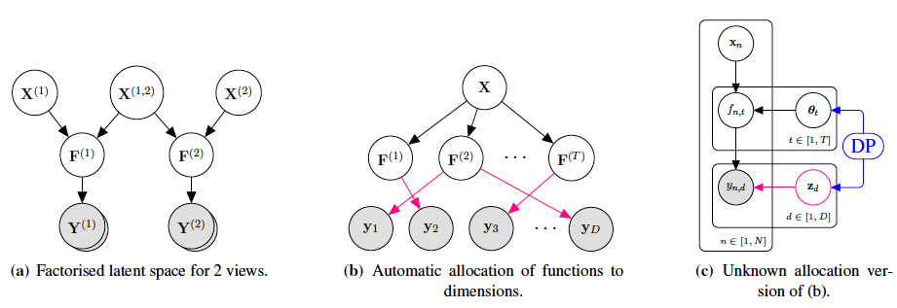
Bayesian Unsupervised Modelling for Learning Non-Linear Correlation in OMICS Data
For the OMICS data, we have a large number of observed data and many different factors (F). We want to learn the unknown correlations between them.
Identify the relevant Factors using the IBFA
to infer the sharing of generative functions (Z) between observed dimensions from data and their number (T)
Use a the DP-GP-LVM, to automatically learn the unknown Z using a Dirichlet Process prior.
with N. Campbell and C.H. Ek

Slide 24
Data Integration: Expectations
In previous (non-biological) applications, these models performed unsupervised learning by selecting informative component in the data (Damianou A. et al. 2016; Ek C.H, et al. 2008). Latent factorised representation of the data
They are sensitive to perturbation in the data and will appropriately define and quantify its uncertainty, by means of latent factors.
This results in an approach that can be highly adaptable to the data and computationally affordable given the large data size we expect to have.
By merging the non-parametric Bayesian latent models with a hierarchical structure of Gaussian processes we can then perform deep inference using the power of uncertainty (Kaiser et al. 2018; Damianou A et al. 2013).

Slide 25
Conclusions and Open Questions
Modern biology studies fine details on large scale and has generated challenges that we can only approach by integrating disciplines in a system-level approach
Quantify uncertainty will play a pivotal role in estimating relevant component of information. Impact of Machine Learning in analysing and using this data is huge
Successful use of Machine Learning methods need to be supported by appropriate experimental designs, good practice and data sharing policies.
What we have learnt from working with bulk population data can be transfer to single-cell. Probabilistic models will give present to opportunity to add prior knowledge to the models.
How can we use the information stored in the DNA to model responses to environmental factor/ perturbations to improve healthcare?
How do we built interpretable networks out of this huge amount of data we have available?

Slide 26





Acknowledgements
Serena Nik-Zainal
Oliver Thompson
Peter Andrews
John Alexander
Pluripotent Stem Cell Platform –PSCP
PSEC
Data Integration
University of Bath
Neill Campbell
University of Bristol
Carl Hernik Hek
Amazon Research UK
Andreas Damianou
GRASPS
Guillaume Hautbergue
Luisa Cutillo
Mario Guarracino
Thank You!

